Slide 1

Indian Institute of Information Technology Allahabad
Prayagraj (UP) India
Geospatial Data Analysis of Prayagraj
Group Members:
Shubham Kumar (IIT2020007)
Anoop Kumar (IIT2020020)
Shashikant Thakur (IIT2020024)
Supervised By :
Dr. Triloki Pant

Slide 2
Index
Topic
Literature Review
Dataset Description
Methodology
Result & Discussion
References

Slide 3
Timeline
C2-C3
C1
C1-C2
C1
C1
C1-C2
Enlarging ROI radius
Making Methodology
Training and evaluation of models
Analysis of 2020 to 2024 data
Literature Review
Ground Truth Collection
Finalising methodology for the task
Performing previous steps on larger ROI
Reading Research Paper
Training the models on raster
Collecting data by visiting different sites
Processing on previous years data and performing change detection

Slide 4
TOPIC
Geospatial data analysis
It involves interpreting data containing spatial or geographic elements using GIS and analytical techniques.
Change detection in prayagraj region, center point taken as IIITA, in the previous five years(2020 - 2024).

Slide 5
Objective of the project
Objective of our project is to classify the land area of the city of Prayagraj into following four classes: Urban area, Barren land area, Vegetation area, Water bodies
Classification will be done with algorithms random forest. On the best performing algorithm on current data, classification of previous 5 year data will be done.
Perform change detection for previous five year(2020 - 2024).

Slide 6
Literature Review
LAND USE AND LAND COVER CLASSIFICATION OF SENTINEL 2-A: ST PETERSBURG CASE STUDY
Objective: Classify St. Petersburg's land use and cover with Sentinel-2A imagery and SVM.
Methodology: Use ESA data, SNAP preprocessing, and SVM for classification,ArcGIS Desktop Software used.
Findings: Achieve 83.64% accuracy, proving Sentinel-2A and SVM's effectiveness.
Significance: Highlights Sentinel-2A's value for precise urban mapping.
Recommendations: Further refine algorithms and data integration for improved mapping.

Slide 7
Literature Review
Classification by using Sentinel-2 Images: A case study in the city of Rome
Objective: Improve land cover classification accuracy in Rome using Sentinel-2 images.
Methodology: Employ MLE and SVM algorithms to classify urban, forest, water, agriculture, and empty land.
Study Area: Rome, with diverse terrain and distinctive building distribution.
Results: Accuracy :
MLE : 92.7%
SVM : 85.25%
Implications: Accurate land cover mapping crucial for environmental planning and management.

Slide 8
Literature Review
Mapping impervious surface area increase and urban pluvial flooding using Sentinel Application Platform (SNAP) and remote sensing data
Objective: To map impervious surface area growth in major Pakistani cities and assess its impact on urban pluvial flooding.
Methodology: Utilized GISAI on Google Earth Engine for impervious surface mapping and Sentinel-1 GRD data for urban flood extent detection.
Findings: Significant increases in impervious surface area were observed in Islamabad, Lahore, and Karachi, correlating with heightened urban pluvial flooding occurrences.
Significance: Provides crucial insights into urbanization dynamics and flood vulnerability, aiding urban planning and flood risk management in Pakistani cities.
Results: Overall Accuracy : Lahore: 0.93 Karachi: 0.86 Islamabad: 0.85
Recommendations: Implement modeling-based solutions for identifying high-risk flood areas and continuously monitor impervious surface growth using remote sensing for enhanced urban resilience.

Slide 9
Literature Review
PIXEL-BASED CLASSIFICATION ANALYSIS OF LAND USE LAND COVER USING SENTINEL-2 AND LANDSAT-8 DATA
Objective: Compare accuracy of LULC classifications from Sentinel-2 and Landsat-8 in Zonguldak
Methodology: Utilized MLC supervised classification with common bands, assessed accuracy using kappa statistics
Findings: Sentinel-2 generally superior, Landsat-8 better in some Sea areas
Significance: Crucial for sustainable land management and urban planning
Results: Sentinel-2: 88.74% accuracy, kappa 0.85; Landsat-8: 83.91% accuracy, kappa 0.78
Recommendations: Explore alternative classification methods, investigate temporal changes using multi-temporal imagery

Slide 10
Literature Review
Land-Use-Change-Analysis-and-Modeling-Using-Open-Source-QGIS
Objective: Analyze land use changes in Boasher Willayat ,Oman (2000-2010) using QGIS.
Methodology: Used ANN and Logistic Regression for Classification of Land Area.
Findings: Urbanization increased while agriculture decreased, with further urban expansion forecasted.
Significance: Demonstrated MOLUSCE's effectiveness in monitoring land use changes.
Result : Accuracy of ANN: 88.96% , Accuracy of Logistic Regression: 92.79%
Recommendations: Advocate for urban planning to manage rapid urbanization, emphasizing governmental intervention and open-source GIS tools' relevance.

Slide 11
Objective: Assess the Random Forest algorithm efficacy in vegetation mapping using Sentinel and SPOT satellite data in the Pays de Brest area.
Methodology: Utilized Sentinel-1, Sentinel-2, and SPOT-6 satellite imagery from 2017; conducted preprocessing and calculated vegetation indices; implemented supervised Random Forest classification with time series stacking.
Findings: Achieved high accuracy in delineating vegetation classes, including summer and winter crops, forests, water bodies, grasslands, and sand dunes.
Significance: Highlights the potential of Random Forest and multi-source satellite data for accurate vegetation monitoring, crucial for environmental management and agricultural planning.
Recommendations: Further exploration of Random Forest application in different regions, incorporation of recent satellite data, and collaboration with stakeholders for land use planning and conservation strategies.
Result : Overall Accuracy: 0.96
Literature Review
Random Forest Classification using Sentinel-1 and Sentinel-2 series for vegetation monitoring in the Pays de Brest (France)

Slide 12
Dataset Description
Sentinel-2 data has been used in our project Sentinel-2 is equipped with an optical instrument payload that samples 13 spectral bands, including:
four bands at 10 m
six bands at 20 m
three bands at 60 m spatial resolution
Ref - https://dataspace.copernicus.eu/explore-data/data-collections/sentinel-data/sentinel-2

Slide 13
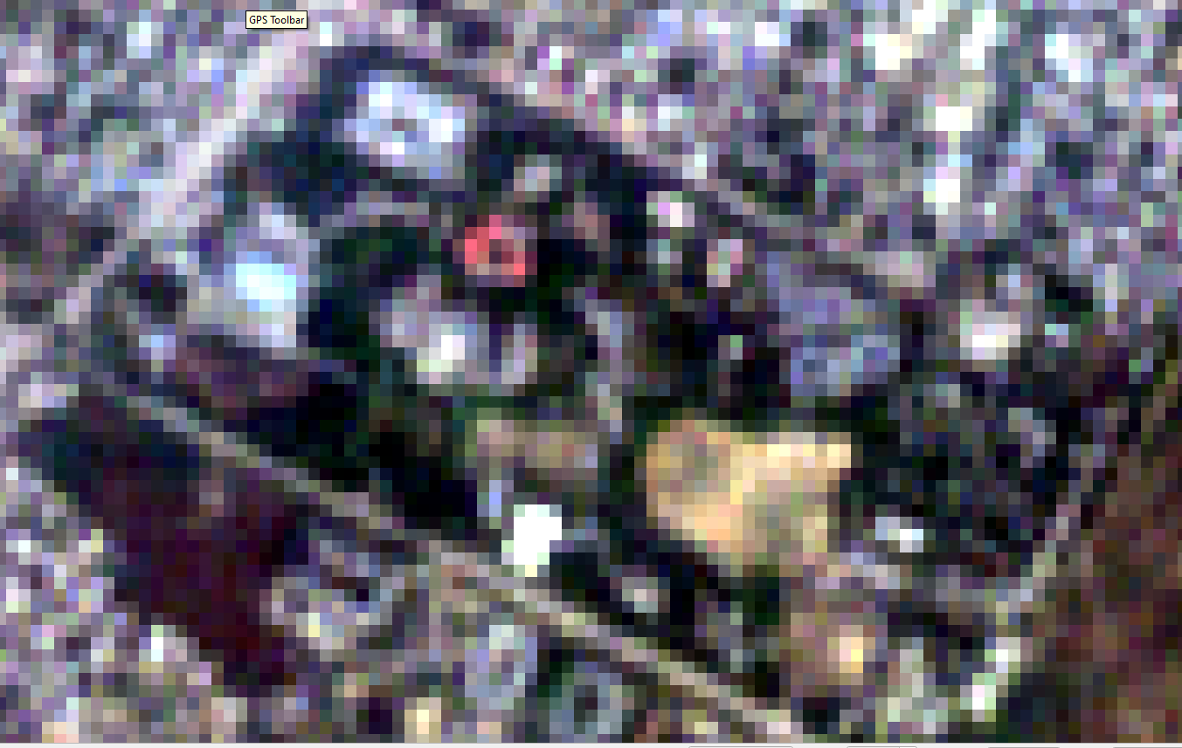
Bands in sentinel-2
Band | Resolution | Central Wavelength | Description
B1 | 60 m | 443 nm | Ultra Blue (Coastal and Aerosol)
B2 | 10 m | 490 nm | Blue
B3 | 10 m | 560 nm | Green
B4 | 10 m | 665 nm | Red
B5 | 20 m | 705 nm | Visible and Near Infrared (VNIR)
B6 | 20 m | 740 nm | Visible and Near Infrared (VNIR)
B7 | 20 m | 783 nm | Visible and Near Infrared (VNIR)
B8 | 10 m | 842 nm | Visible and Near Infrared (VNIR)
B8a | 20 m | 865 nm | Visible and Near Infrared (VNIR)
B9 | 60 m | 940 nm | Short Wave Infrared (SWIR)
B10 | 60 m | 1375 nm | Short Wave Infrared (SWIR)
B11 | 20 m | 1610 nm | Short Wave Infrared (SWIR)
B12 | 20 m | 2190 nm | Short Wave Infrared (SWIR)
ROI(IIITA)

Slide 14
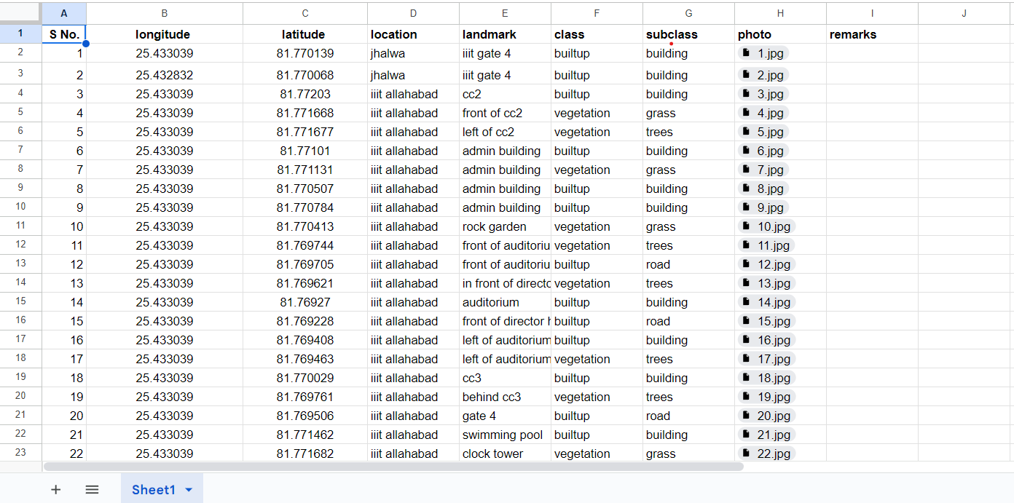
Collection of ground truth data of IIITA (60 points) [6]
We have collected 250 ground truth locations from region of IIITA, near IIITA, Kalindipuram, Civil Lines, Sangam region

Slide 15
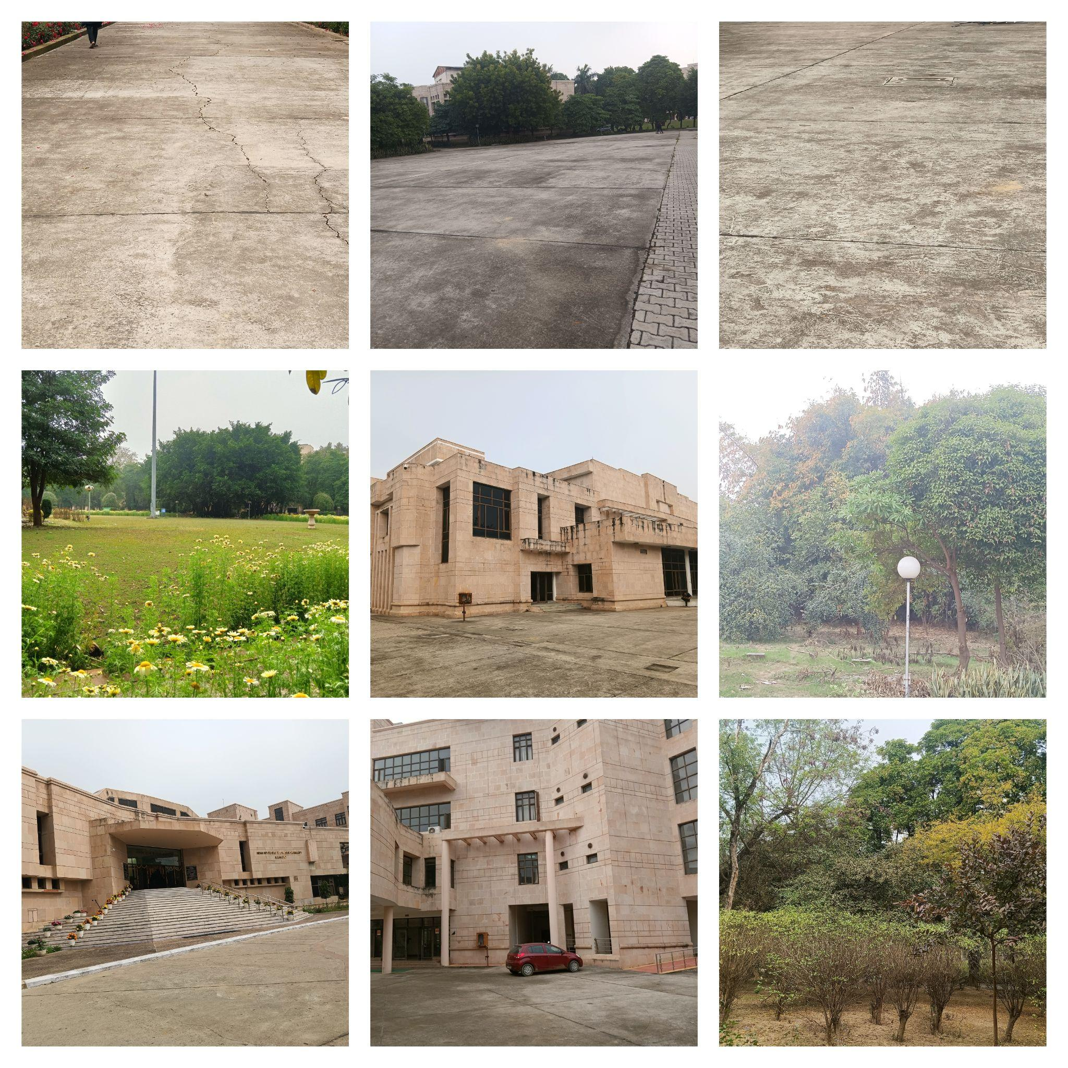
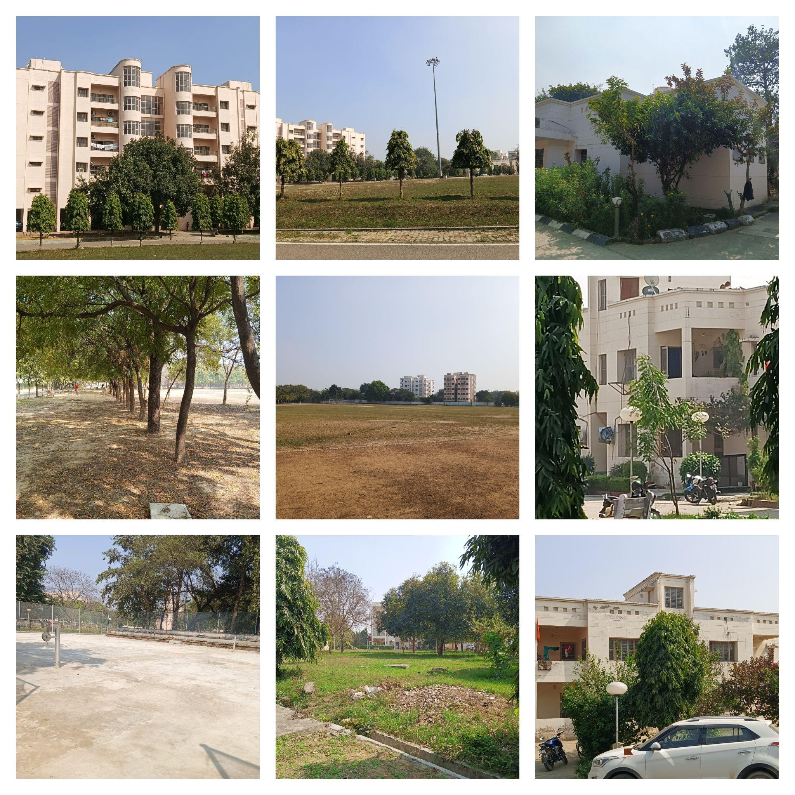

Slide 16
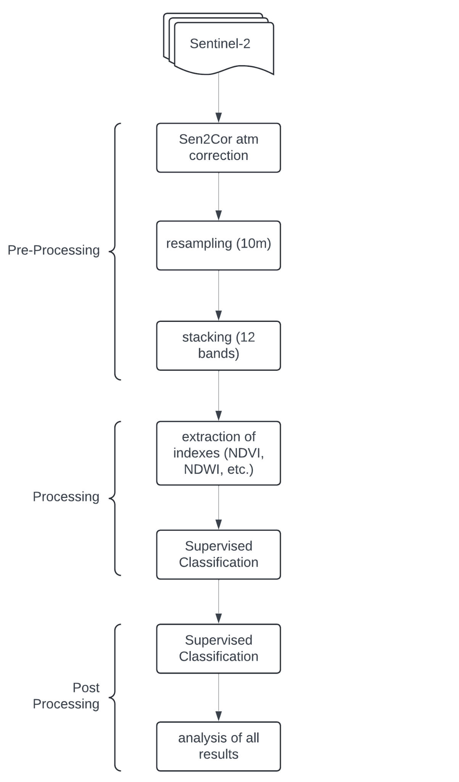
Flow Diagram

Slide 17
Methodology
Data Acquisition: Collection of Sentinel-2 satellite data with minimum could cover.
Image Preprocessing:
Perform image preprocessing tasks such as atmospheric corrections to enhance the quality of the imagery.
Image Clipping: Clip the required ROI raster by overlaying vector over raster.
Training Data Collection:
Collect ground truth data representing the four land cover classes (Barren Land, vegetation, built-up, water) through field surveys or existing land cover datasets.
Classification Algorithm:
Split the reference dataset into training and validation sets to train and assess the performance of the classification algorithm.
Classification using Random Forest algorithm.
Model evaluation : Evaluate classification by matrix like accuracy and f1-score.
Visualization: Visualize the classified map for interpretation.
Classification of Previous years data: Repeat above steps for previous 5 years data(2019-2023).
Analysis of results for year on 2020 to 2024
basis for previous five years.

Slide 18
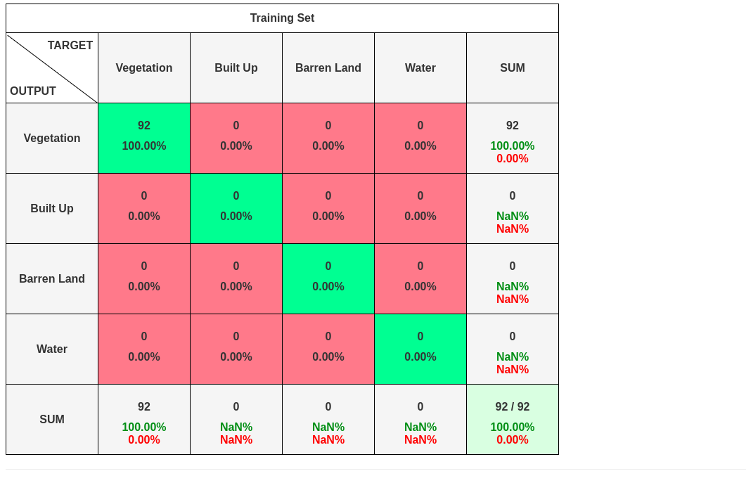
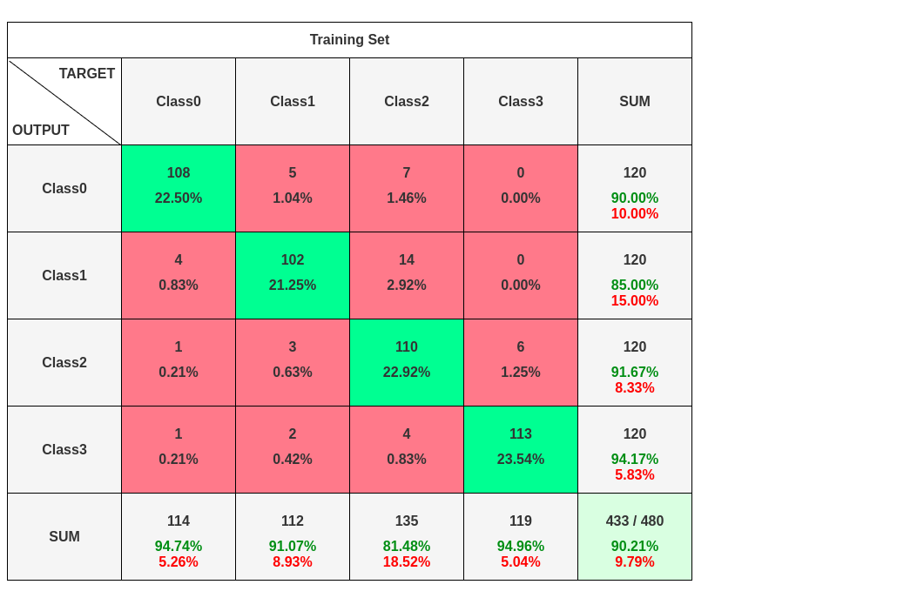
Confusion Matrix
(2024)

Slide 19
Results and Analysis
Accuracy : 0.9021
Misclassification Rate : 0.0979
Weighted-F1 : 0.9015

Slide 20
Results and Analysis
Type | 2020 | 2021 | 2022 | 2023 | 2024
Vegetation | 36.150 | 42.937 | 45.498 | 29.911 | 34.942
Built Up | 7.812 | 8.962 | 9.716 | 10.050 | 10.320
Barren Land | 51.6626 | 45.448 | 42.823 | 54.811 | 52.893
Water | 4.375 | 2.654 | 1.963 | 5.228 | 1.837

Slide 21
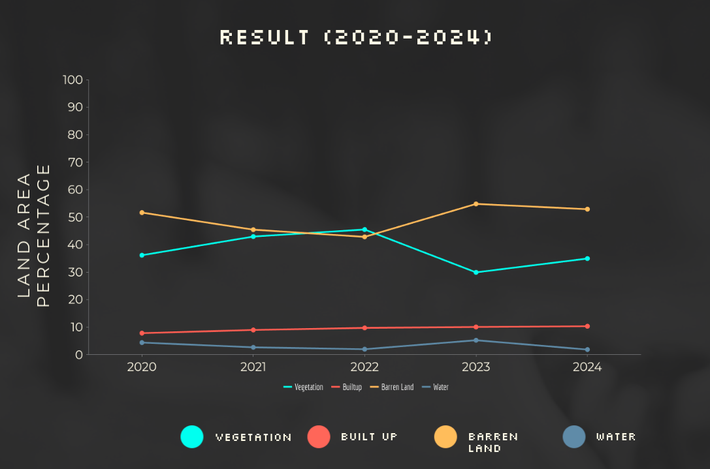

Slide 22
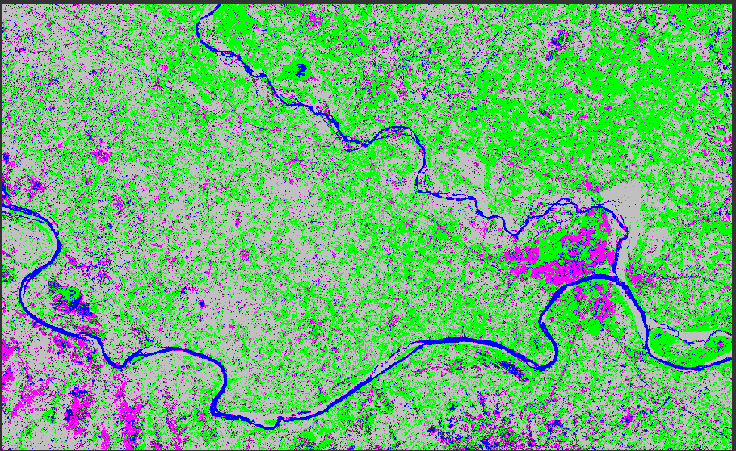
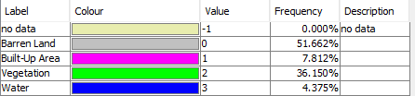
Results and Analysis
2020

Slide 23
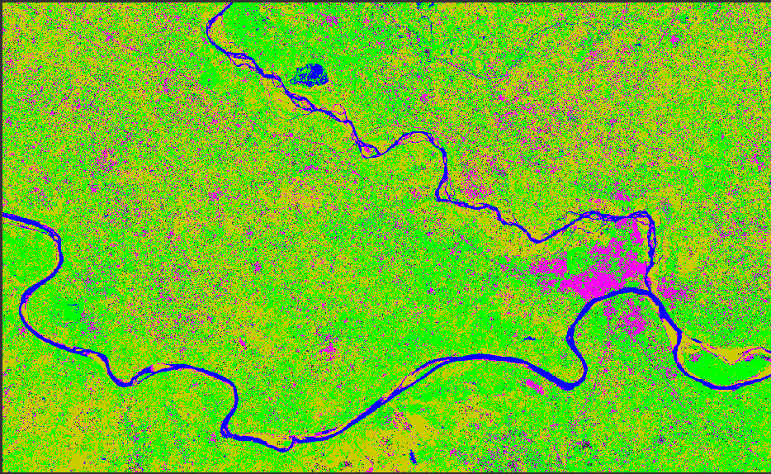
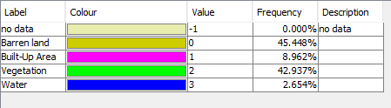
Results and Analysis
2021

Slide 24
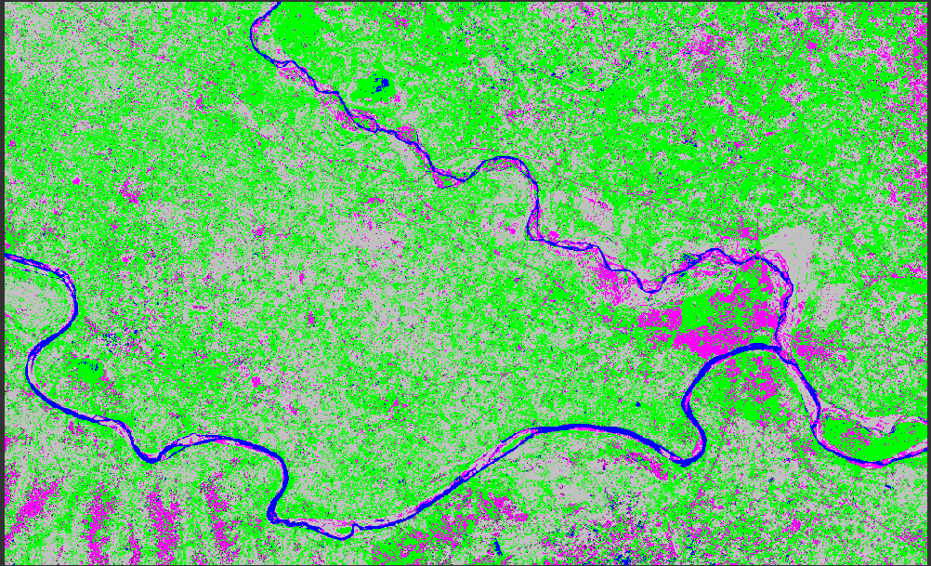
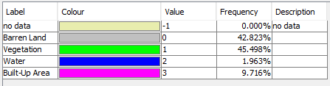
Results and Analysis
2022

Slide 25
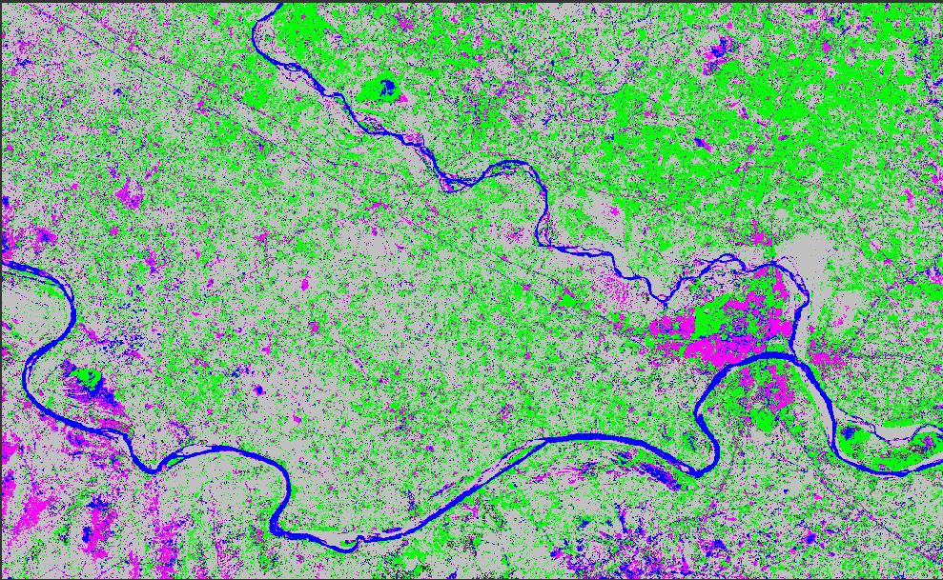
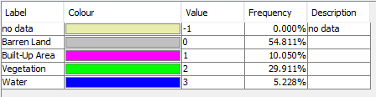
Results and Analysis
2023

Slide 26
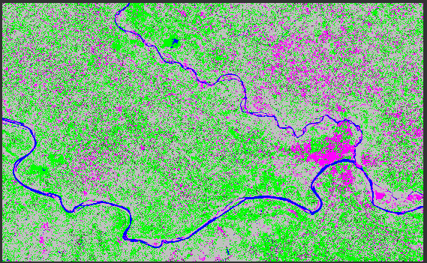
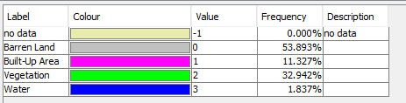
Results and Analysis
2024

Slide 27
References
1. M. N. Ahmad, Z. Shao, A. Javed (2023)"Mapping Impervious Surface Area Increase and Urban Pluvial Flooding Using Sentinel Application Platform (SNAP) and Remote Sensing Data."Environ Sci Pollut Res 30, 125741–125758 Paper Link
2. M. Cavur, H. S. Duzgun, S. Kemec, D. C. Demirkan,(2019) "Land Use and Land Cover Classification of Sentinel-2A: St Petersburg Case Study."International Archives of the Photogrammetry, Remote Sensing and Spatial Information Sciences, XLII-1/W2, 13–16 Paper Link
3. M. Majidi Nezhad, A. Heydari, L. Fusilli, G. Laneve,(2019) "Land Cover Classification by Using Sentinel-2 Images: A Case Study in the City of Rome."In Proceedings of the 4th World Congress on Civil, Structural, and Environmental Engineering (ICEPTP19) (pp. 1–April). Environmental Science. DOI: 10.11159/ICEPTP19.158 Paper Link
4. A. Sekertekin, A. M. Marangoz, H. Akcin, (2017)"Pixel-Based Classification Analysis of Land Use Land Cover Using Sentinel-2 and Landsat-8 Data." . International Archives of the Photogrammetry, Remote Sensing and Spatial Information Sciences, (pp. 91-93) XLII-4/W6 Paper Link
5. A. N. M. Al-Rubkhi,(2017) "Land Use Change Analysis and Modeling Using Open Source (QGIS).Case Study: Boasher Willayat"Paper Link

Slide 28
References
[06] Niculescu, S., Billey, A., & Talab-Ouali, H. (Year). Random Forest Classification using Sentinel-1 and Sentinel-2 series for vegetation monitoring in the Pays de Brest (France). Remote Sensing for Agriculture, Ecosystems, and Hydrology XX, Christopher M. U. Neale & Antonino Maltese (Eds.), Proc. of SPIE Vol. 10783 (pp. 1078305-1). SPIE. doi:10.1117/12.2325546
Paper Link
[7] Atmospheric / Topographic Correction for Satellite Imagery
[8] Atmospheric Correction in Sentinel-2
[9] Kappa Coefficient
[10] Vector Image
[11] Change Detection Algorithm

Slide 29
Thank You

Slide 30
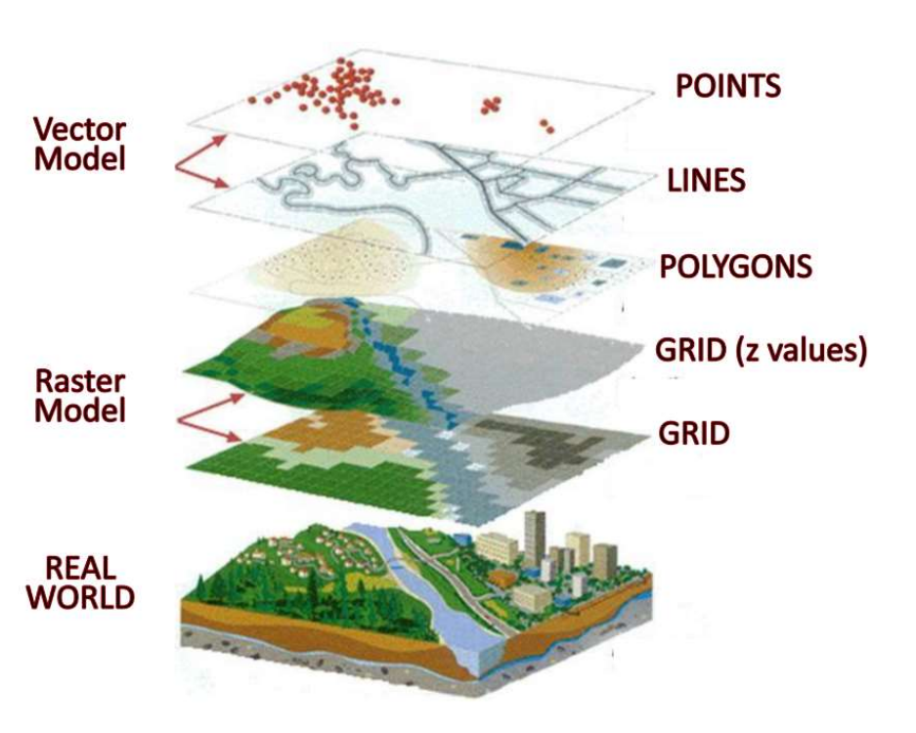
Clipping: Methodology
[9]

Slide 31
Algorithm for change detection
Change detection is useful n areas with natural calamities like forest fire, floods, etc. Since Allahabad is also a flood prone areas we want to analyse the changes that are happening in land area of Prayagraj. This will give us an insight about how the changes are happening in Prayagraj.

Slide 32
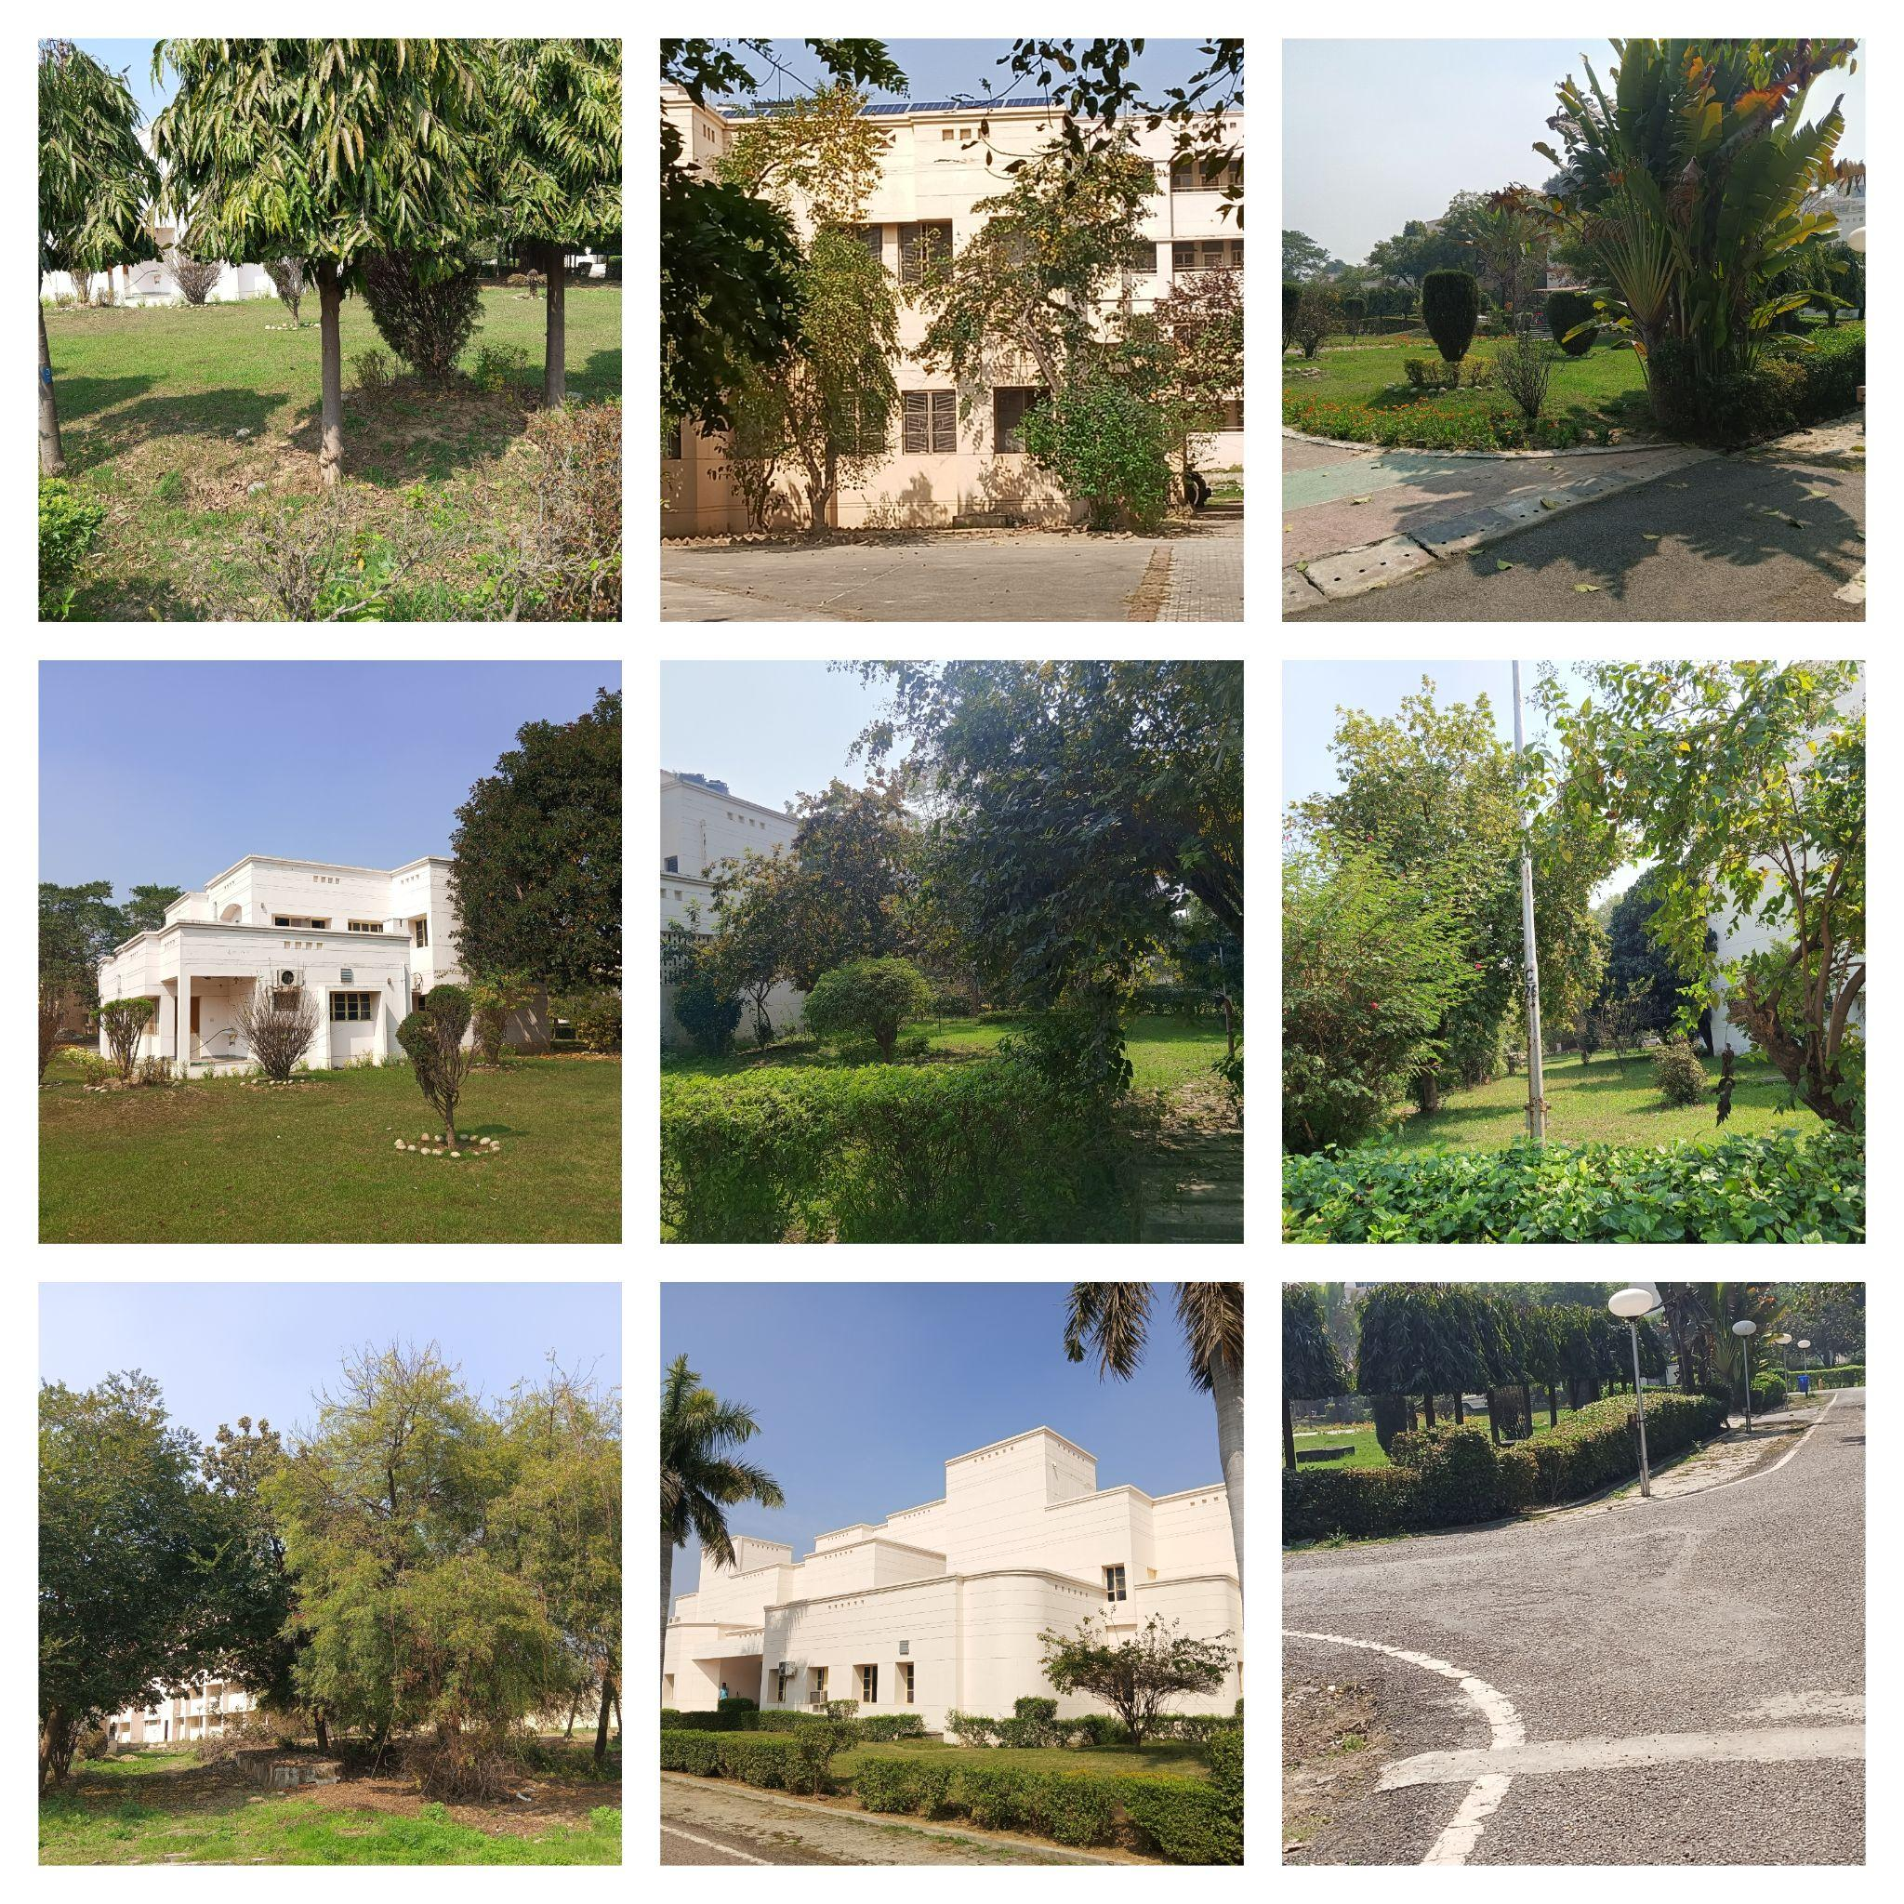
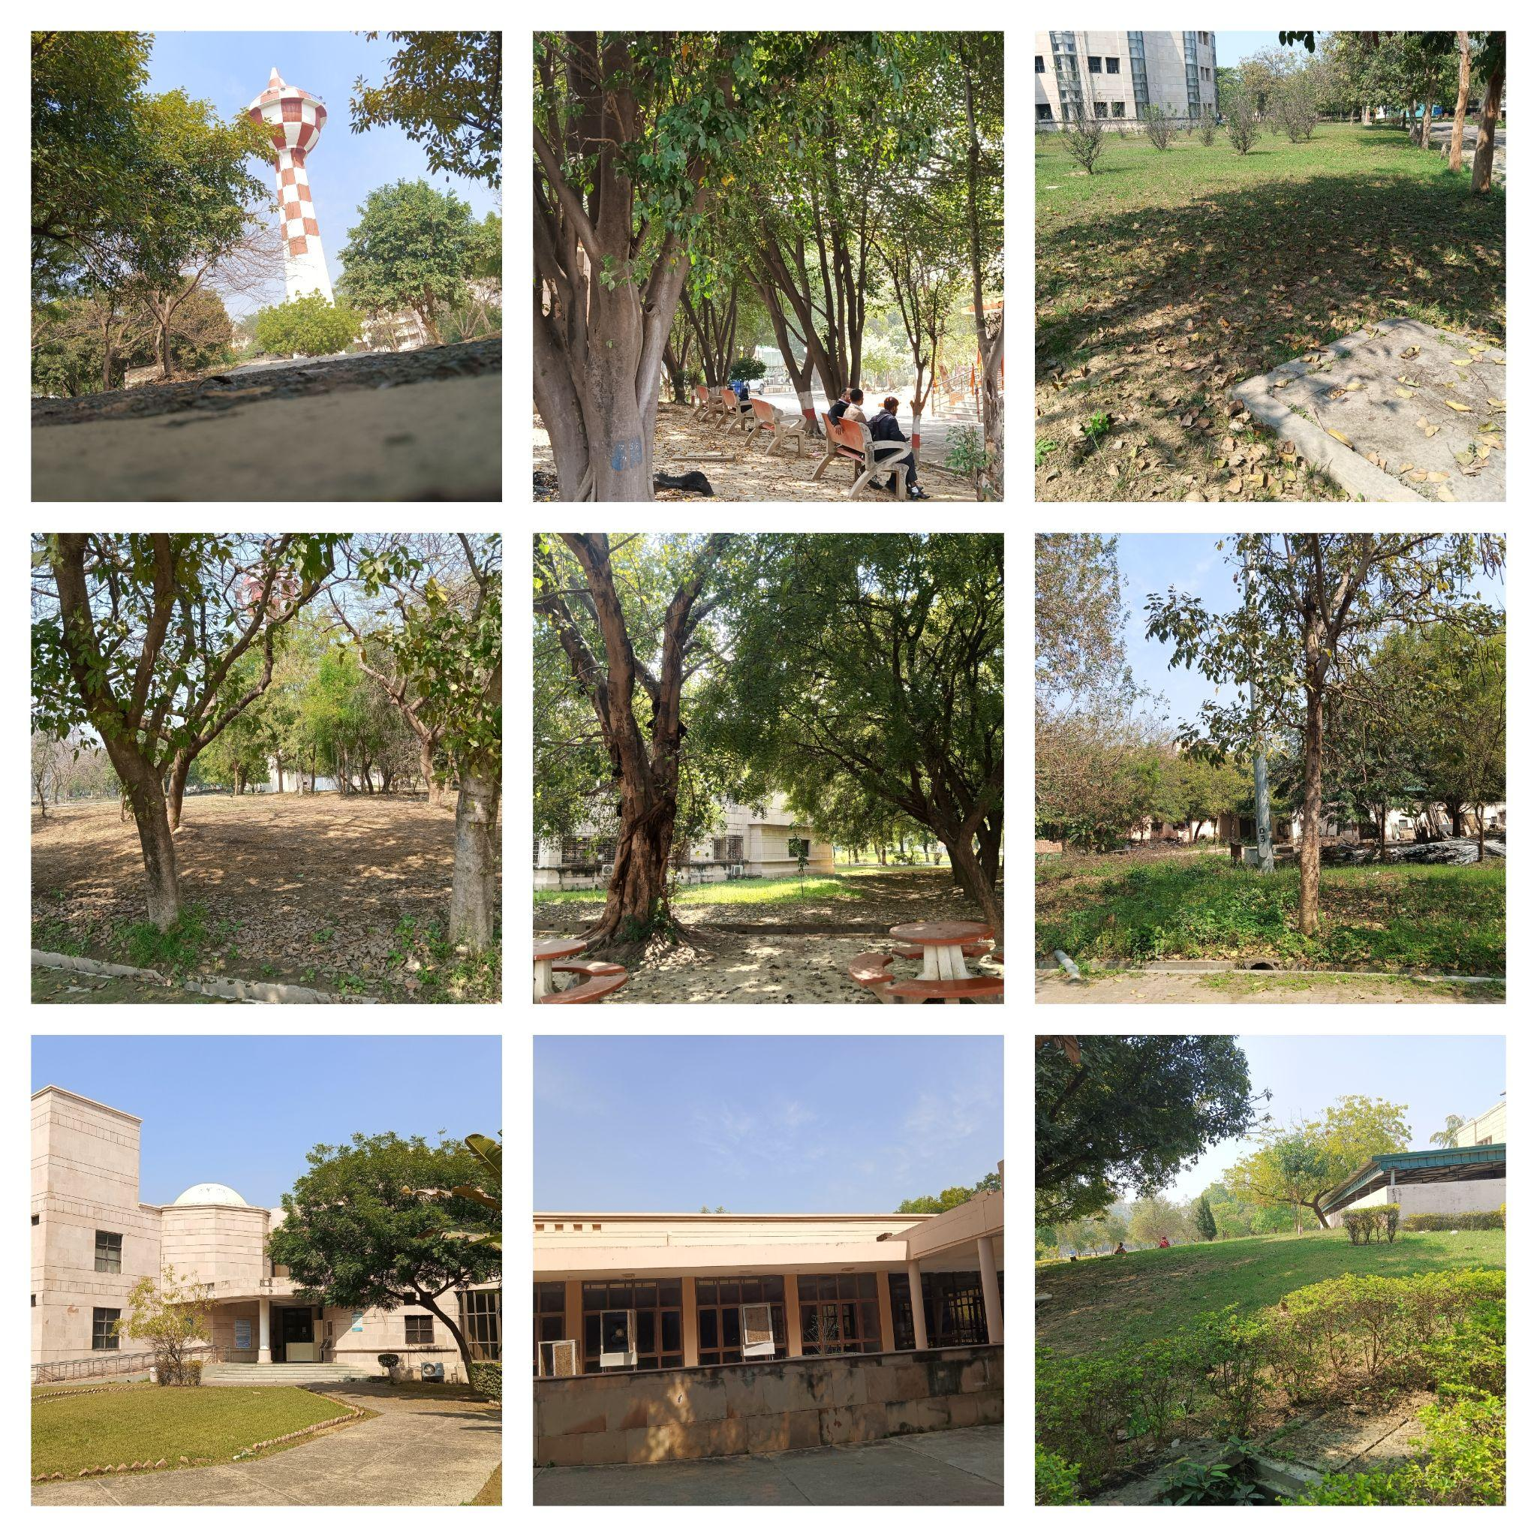

Slide 33
Semi-Automatic Classification Plugin (SCP)
1. SCP is a plugin for QGIS designed for semi-automatic image classification.
2. It simplifies the process of remote sensing data analysis and classification tasks.
3. SCP supports various classification algorithms and provides tools for accuracy assessment.
4. Users can follow a step-by-step workflow for loading, preprocessing, classifying, and evaluating results.
5. SCP enhances the efficiency and accuracy of image classification within the QGIS environment.

Slide 34
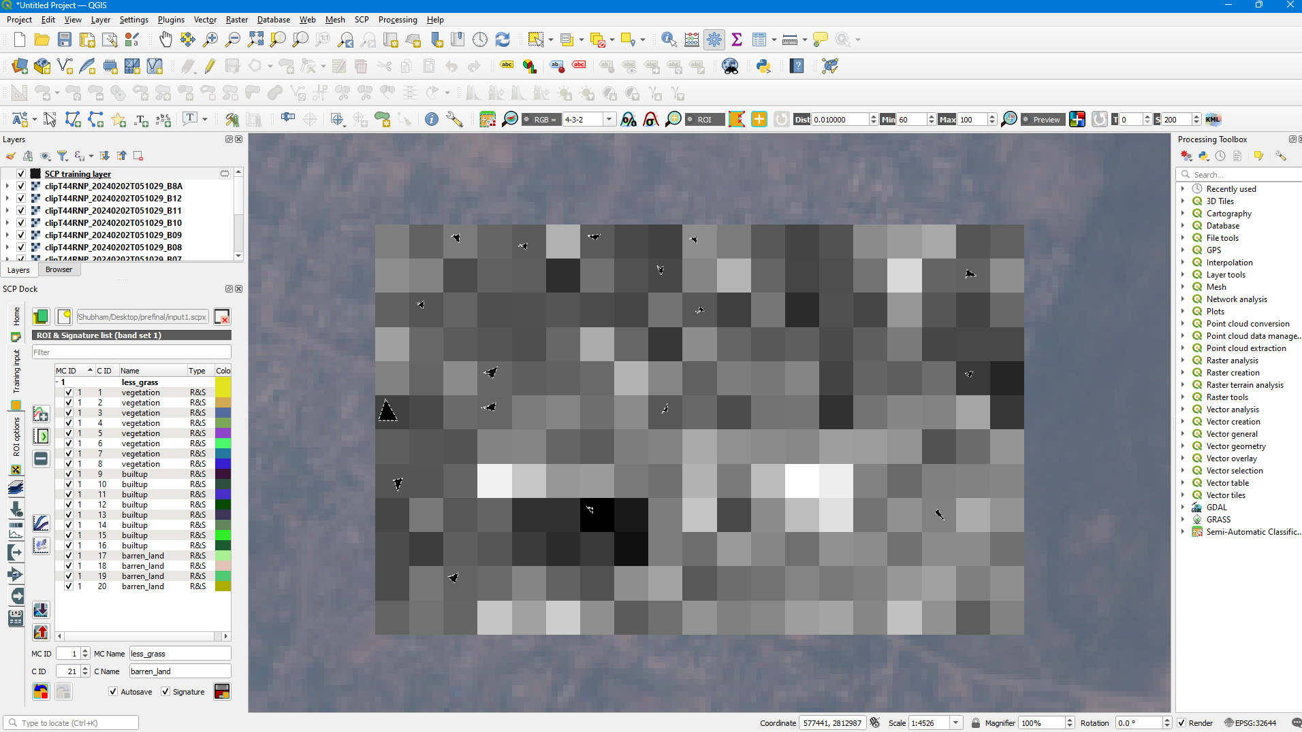
Progress………………………………………………………………………………………………………………………………

Slide 35
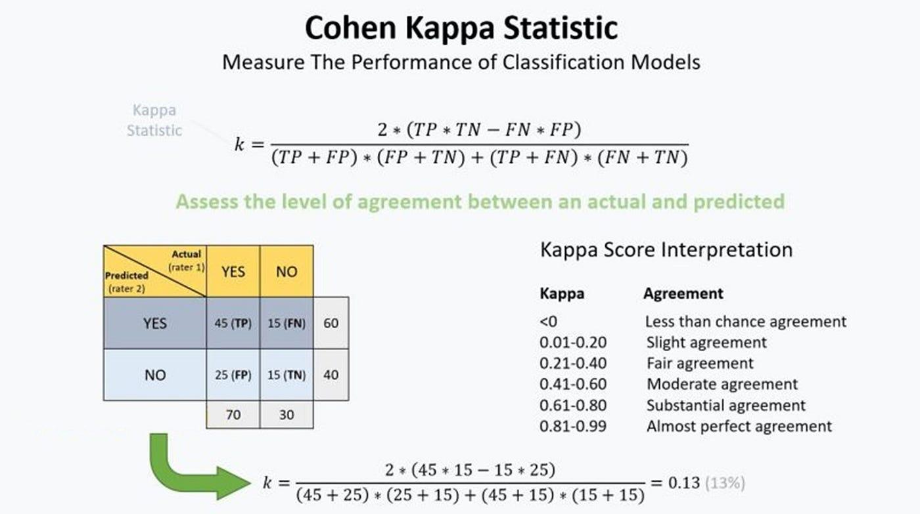

Slide 36
Kappa Coefficient
Cohen's Kappa and F1 score serve different purposes in the evaluation of machine learning models, and each has its own advantages based on the specific requirements of a task. Here are some advantages of Cohen's Kappa over F1 score and vice versa:
Advantages of Cohen's Kappa:
Handles Class Imbalance:
Kappa is less sensitive to class imbalance than F1 score. In situations where one class significantly outnumbers the others, Kappa can provide a more balanced measure of agreement.
Accounts for Chance Agreement:
Kappa corrects for the agreement that could occur by chance alone. This makes it particularly useful when there is a random element in the classification, or when there might be agreement by luck.
Interpretability:
Kappa is more interpretable as it directly measures agreement in terms of chance-corrected concordance. This can be useful in scenarios where the goal is to have reliable and consistent predictions across different raters or classifiers.
Applicability to Multiclass Problems:
Cohen's Kappa can be extended to handle multi-class classification problems, providing a measure of overall agreement that considers chance agreement for multiple classes.

Slide 37
ALGORITHMS

